Slide 1


Chapter 3
Form Interactions
Department of E-Commerce
Faculty of Science and Information Technology
Kolej Universiti Islam Antarabangsa Selangor (KUIS)
http://www.kuis.edu.my/fstm

Slide 2


<form name=“aform” method=“GET” action=“save.php”>
input…
</form>
This is the typical structure of form:
  name: is the name of the form.
  method: how the data is transferred (POST or GET).
  action: is the target file resides in the Web server that receive the data from the form.
  input: are the input elements (text field, checkbox, radio button, etc.).

Slide 3

GET | POST
Is basically for just getting (retrieving) data. The variable name and the value appear and visible in the URL. Form data is to be encoded (by a browser) into at the end of the URL of the target file. | Form data is embedded within a message body. POST may involve anything, like storing files to the server, updating data, ordering a product, or sending an e-mail. The variable name and the value do not appear in the URL.

Slide 4
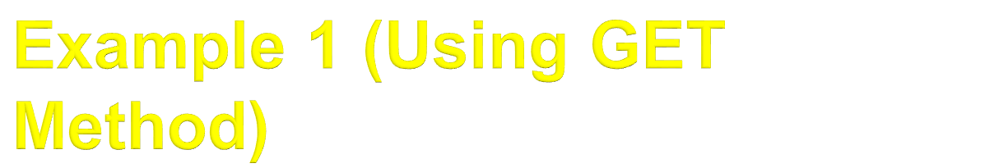

Slide 5

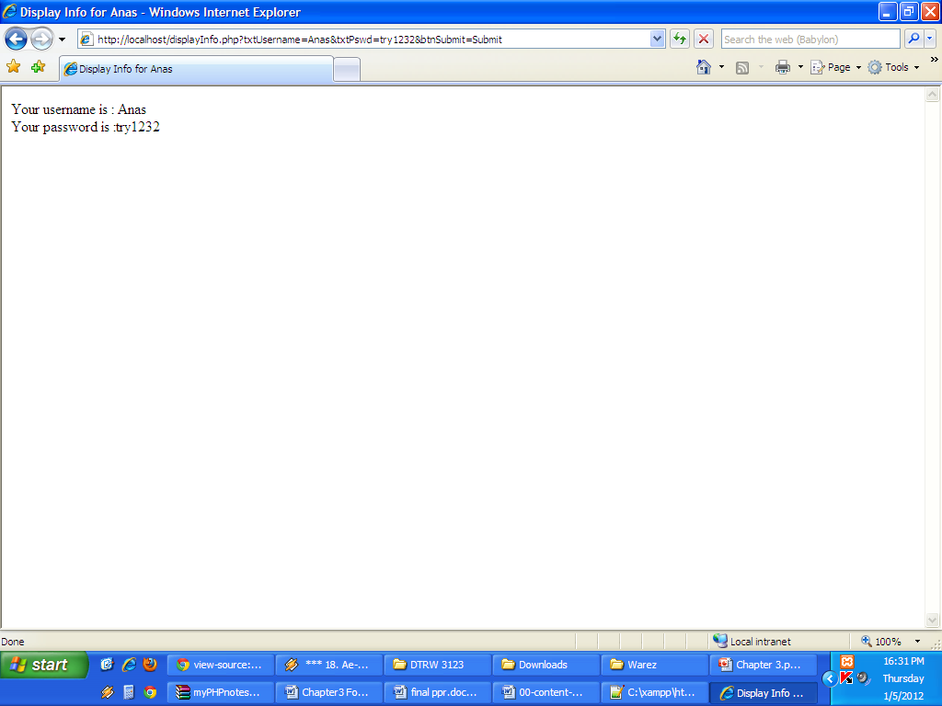

Slide 6
Since PHP is a server-side scripting, it is interpreted/executed inside the server.
The output of the script execution is embedded inside the page which contains the script.
At the end of the process, the HTML page, together with the output generated, is sent to the browser (client).
The script will not be included in the HTML page sent to the browser.

Slide 7
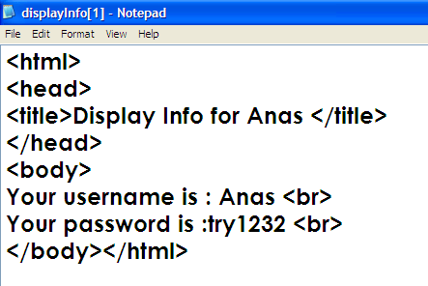

Slide 8


Slide 9
